Slide 1
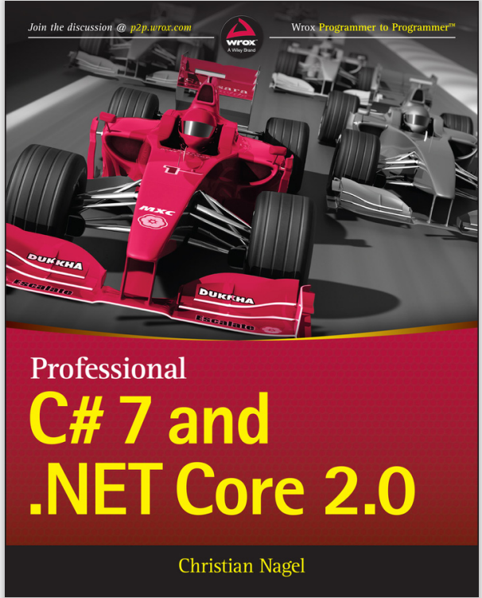
Programming
Chapter 7
Array, functions, some libraries in C#
[Book name]

Slide 2
Arrays
The variables we have been working with so far have only been able to hold one value at a time
Example:
int a = 1;
int b=2;
An array allows you to use just one identifying name that refers to losts of values

Slide 3
How to setup an array
Declare the array:. You can use any valid C# data type to define the type of the array elements.
int[] myArray;
Initialize the array:
Fixed size initialization:
int[] myArray = new int[5];
b. Initial values initialization:
int[] myArray = new int[] {1, 2, 3, 4, 5};
c. Implicit initialization
int[] myArray = {1, 2, 3, 4, 5};

Slide 4
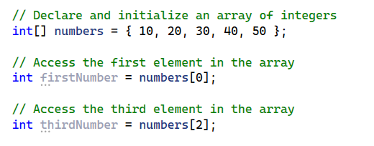
Accessing array element
You access an array element by referring to the index number.
The index represents the position of the element in the array and starts from 0 for the first element, 1 for the second element, and so on

Slide 5
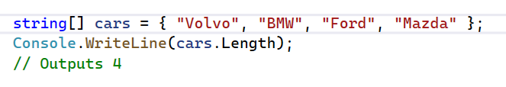
Array Length
To find out how many elements an array has, use the Length property

Slide 6
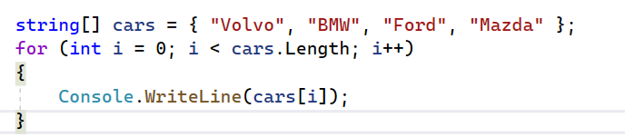
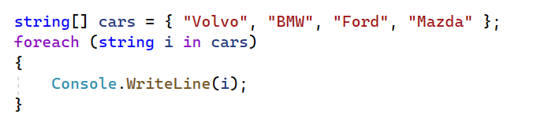
Arrays and loops
You can loop through the array elements with the for loop, and use the Length property to specify how many times the loop should run.
The foreach Loop

Slide 7
Functions
Real world applications become more complex and large, several problems arise
Algorithm are more complex, hence more difficult to design
Implementation of complex algorithm is difficult because of the size of the program
Larger program, testing, debugging, and maintenance will be difficult
Complex problems can be solved by breaking them into a set of sub-problems (modules)
Each is implemented independently
Then can be combined to a single unit
C# supports modularity by means of functions (or methods)

Slide 8
Advantages of functions
Facilitates top-down modular programming
Modularity brings logical clarity to the programs
Avoids the need for redundant code
Repeated instructions can be written as a function
Which can then be called whenever it is needed
Facilitates reusability
Created in one program can be used in others

Slide 9
Function prototypes
Like variables, functions must be declared before it’s called
Declaration of a function is called Function Prototype or signature (name) of the function
Function prototype specifies
The signature (name) of the function
The return type
Number and data types of the parameters

Slide 10
Functions
A function allows you to encapsulate a piece of code and call it from other parts of your code
You may very soon run into a situation where you need to repeat a piece of code, from multiple places, and this is where functions come in
<access specifier> <return type> <function name>(<parameters>) { //function body
//return statement }

Slide 11
Components of a function
Function name: It is used to specify a unique name to be used for calling a Function.
Return type: It is used to define the data type of the return value of the function.
Body: It is used to define a block for executable statements.
Access specifier: It is used to define the accessibility of the function in an application.
Parameters: It is used to specify a list of parameters to be passed during the function call.
Note: It is optional to specify the Access-specifier, parameters and return statement.

Slide 12
Example: function definition

Slide 13
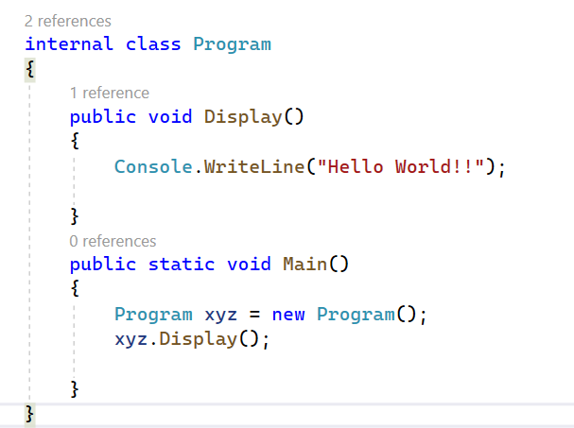
C# Function: using no parameter and return type

Slide 14
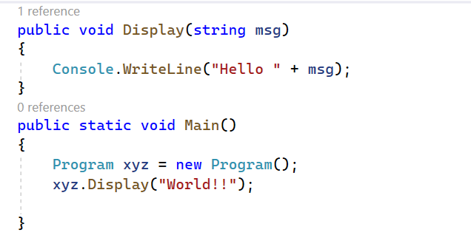
C# Function: using parameter but no return type

Slide 15
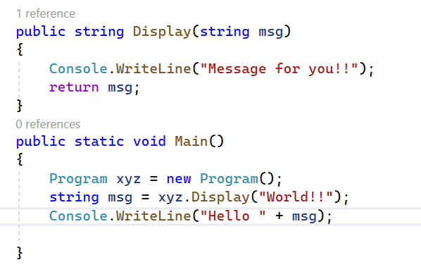
C# Function: using parameter and return type

Slide 16
Local/Global variables
Local variables are declared inside a function, they are local to that function
It can be accessed only within that function
Memory for it is allocated only when the function is invoked
Memory for it is de-allocated when the control moves out of the function
Global variables are declared outside of the functions, they are common to all functions
It can be accessed by all functions in the program
Memory for it is allocated when “program” gets executed
Memory is de-allocated only at the end of the “program” execution
Notes:
Thực ra là class nhưng sinh viên chưa học OOP nên tạm để là “program”

Slide 17
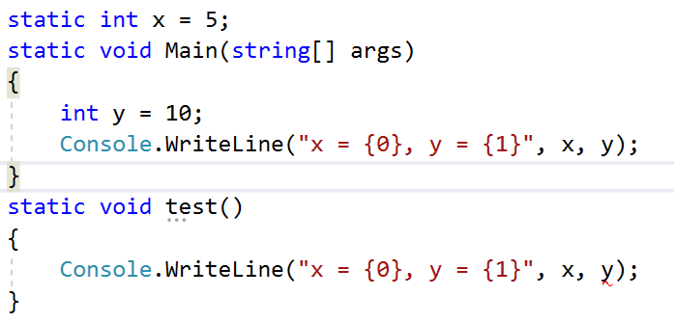
Example: local/global variables

Slide 18
Return statement
It’s used to transfer the control back to the calling program
Function may or may not return a value
If it returns a value, it is achieved by the return statement
There could be multiple return statements
General form
return;
return (expression);

Slide 19
Example: return statement

Slide 20
Function call
Functions are invoked by
Specifying its name,
Followed by a list of arguments within parentheses
General form
[variable name =] function-name(actual-argument)
When the function is encountered, the control is transferred to the called function
Means the statement(s) of the function is executed
LHS variable is optional
It’s used to store returning values from the function

Slide 21
Example: Find larger integer

Slide 22
Passing arguments
The values of the actual arguments are copied into the respective formal arguments
Actual and formal arguments
Refer to the different memory locations and
Value of actual argument is copied into the formal argument
So, any changes made to the formal argument are not reflected in their corresponding actual arguments
Notes:
Giải thích kỹ về tham số hình thức và tham số thực

Slide 23
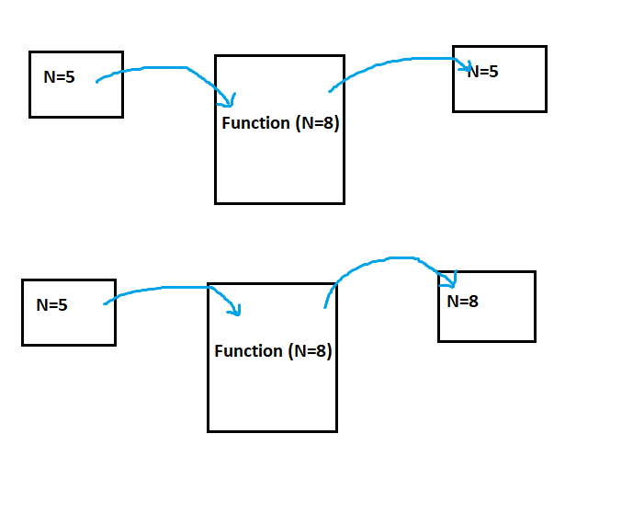
CALL BY VALUE & CALL BY REFERENCE

Slide 24
Example : Call by value
static void fn1(int a)
{
a = a + 5;
Console.WriteLine("a in fn1={0}",a);
}
public static void Main()
{
int a = 5;
Console.WriteLine("a before call fn1={0}", a);
fn1(a);
Console.WriteLine("a after call fn1={0}", a);
Console.ReadLine();
}

Slide 25
Example: call by reference
static void fn2(ref int b)
{
b= b+2;
Console.WriteLine("b in fn2={0}",b);
}
public static void Main()
{
int b = 10;
Console.WriteLine("b before call fn2={0}", b);
fn2(ref b);
Console.WriteLine("b after call fn2={0}", b);
Console.ReadLine();
}

Slide 26
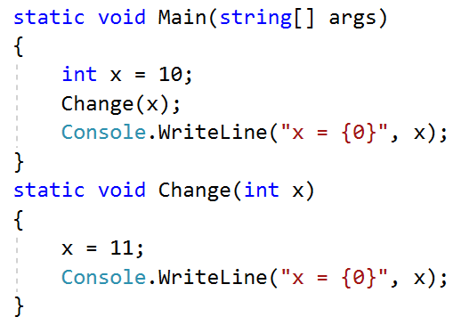
Call/Pass by value example

Slide 27
Some libraries
Math
Math.PI
Math.Sqrt(x)
Math.Pow(x,y)
Math.Min(x,y)
Math.Max(x,y)
Math.Round(5.674,1)
Math.Sin(), Math.Cos, …

Slide 28
Some libraries
Random
Random rd = new Random();
[0…100)
int x = rd.Next(100);
[-50…101)
int z = rd.Next(-50,101);

Slide 29
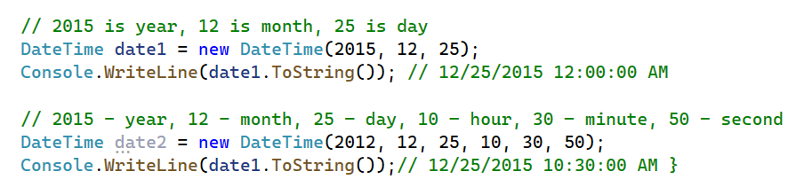
DateTime
C# DateTime is a structure of value Type like int, double etc
DateTime Constructor: It initializes a new instance of DateTime object

Slide 30
DateTime properties
DateTime myDate = new DateTime(2015, 12, 25, 10, 30, 45);
int year = myDate.Year; // 2015
int month = myDate.Month; //12
int day = myDate.Day; // 25
int hour = myDate.Hour; // 10
int minute = myDate.Minute; // 30
int second = myDate.Second; // 45
int weekDay = (int)myDate.DayOfWeek; // 5 due to Friday

Slide 31
DateTime Formatting
Speicifier | DateTimeFormatInfo | Value(en-US culture)
t | ShortTimePattern | h:mm tt
d | ShortDatePattern | M/d/yyyy
T | LongTimePattern | h:mm:ss tt
D | LongDatePattern | dddd, MMMM dd, yyyy
f | (combination of D and t) | dddd, MMMM dd, yyyy h:mm tt
F | FullDateTimePattern | dddd, MMMM dd, yyyy h:mm:ss tt
g | (combination of d and t) | M/d/yyyy h:mm tt
G | (combination of d and T) | M/d/yyyy h:mm:ss tt
m, M | MonthDayPattern | MMMM dd
y, Y | YearMonthPattern | MMMM, yyyy
r, R | RFC1123Pattern | ddd, dd MMM yyyy HH':'mm':'ss 'GMT'(*)
s | SortableDateTi­mePattern | yyyy'-'MM'-'dd'T'HH':'mm':'ss (*)
u | UniversalSorta­bleDateTimePat­tern | yyyy'-'MM'-'dd HH':'mm':'ss'Z' (*)

Slide 32
Parse string to DateTime object
CultureInfo culture = new CultureInfo("en-US");
DateTime dateTimeObj = Convert.ToDateTime("10/22/2015 12:10:15 PM", culture);
DateTime dateTimeObj = DateTime.Parse("10/22/2015 12:10:15 PM");
DateTime dateTimeObj = DateTime.ParseExact("10-22-2015", "MM-dd-yyyy", provider); // 10/22/2015 12:00:00 AM
DateTime dateTimeObj; // 10-22-2015 12:00:00 AM
bool isSuccess = DateTime.TryParse("10-22-2015", out dateTimeObj); // True
DateTime dateTimeObj; // 10/22/2015 12:00:00 AM
CultureInfo provider = CultureInfo.InvariantCulture;
bool isSuccess = DateTime.TryParseExact("10-22-2015", "MM-dd-yyyy", provider, DateTimeStyles.None, out dateTimeObj); // True

